Slide 1
INTRODUCTION TO TEST AUTOMATION
GABRIEL CARABAT, October 2018

Slide 2
AGENDA
Define “test automation”
Test automation process
Automation tools
Framework approach
Best Practices and benefits of TA

Slide 3
DEFINE TEST AUTOMATION
Test Automation
is the use of special software (separate from the software being
tested) to control the execution of tests and the comparison of
actual outcomes with predicted outcomes

Slide 4
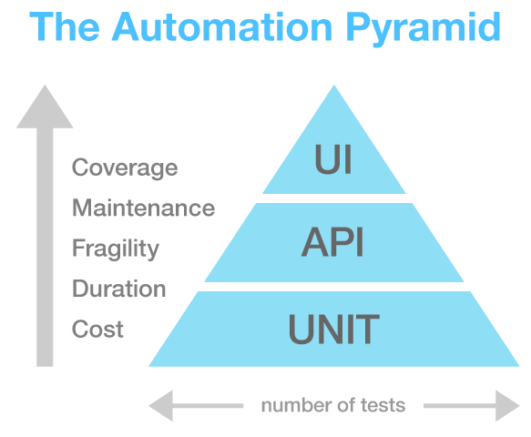
DEFINE TEST AUTOMATION

Slide 5
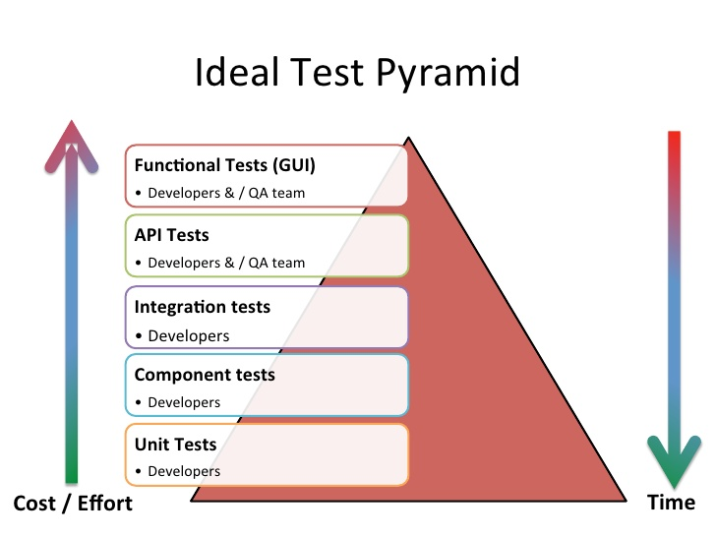
DEFINE TEST AUTOMATION

Slide 6
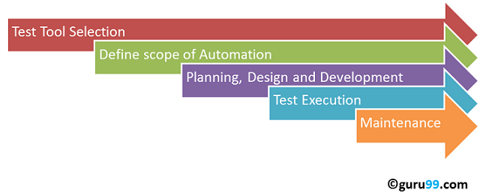
AUTOMATED TESTING PROCESS

Slide 7




AUTOMATION TOOLS
Open Source Tools
Selenium
Watir
Rest Assured
JMeter
Commercial Tools
QTP
IBM Rational robot
SmartBear TestComplete

Slide 8
AUTOMATION TOOLS
Selenium-WebDriver supports the following browsers along with the operating systems these browsers are compatible with:
Google Chrome
Internet Explorer 7, 8, 9, 10, and 11 on appropriate combinations of Vista, Windows 7, Windows 8, and Windows 8.1
As of April 15 2014, IE 6 is no longer supported
The driver supports running 32-bit and 64-bit versions of the browser where applicable
Firefox: latest ESR, previous ESR, current release, one previous release
Safari
Opera
HtmlUnit
phantomjs
Android (with Selendroid or appium)
iOS (with ios-driver or appium)
Programming languages Java, Ruby, RSpec, Python, C#, etc
Documentation: https://www.seleniumhq.org/projects/webdriver/

Slide 9
AUTOMATION TOOLS
Selenium IDE (Integrated Development Environment) is a prototyping tool for building test scripts:
Google Chrome
It is a Firefox and Chrome plugin and provides an easy-to-use interface for developing automated tests.
Selenium IDE has a recording feature, which records user actions as they are performed and then exports them as a
reusable script in one of many programming languages that can be later executed
Programming languages Java, Ruby, RSpec, Python, C#, etc
Selenium-Grid
Allows the Selenium solution to scale for large test suites and for test suites that must be run in multiple environments
Selenium Grid allows you to run your tests in parallel, that is, different tests can be run at the same time
on different remote machines
If you have a large test suite, or a slow-running test suite, you can boost its performance substantially
by using Selenium Grid to divide your test suite to run different tests at the same time using those different machines
To run your tests against multiple browsers, multiple versions of browser, and browsers running
on different operating systems.

Slide 10

TEST TOOL SELECTION
How to Choose an Automation Tool
Environment Support
Ease of use
Scripting Language Used
Support for various types of test - including functional, test management, mobile, etc...
Support for multiple testing frameworks
Easy to debug the automation software scripts
Ability to recognize objects in any environment
Extensive test reports and results
Minimize training cost of selected tools
Hands-on
Identify the requirements
Explore various tools and its capabilities
Set the expectation from the tool and go
Make POCs

Slide 11
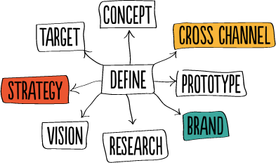
DEFINE THE SCOPE OF AUTOMATION
Regression testing
Risk grows with complexity - Small changes can have huge impact and consequences
What features have broke before
Functional testing
Check static content and elements from a web page
Handle dynamic elements in order to check a specific functionality
i.e create account, login, search user, update user
Compatibility testing
Ability to use the same test cases for cross-browser testing
ecide based on what browsers are used most by the end users of the application under test

Slide 12

DEFINE THE SCOPE OF AUTOMATION
Business view
Automate the features that are important for the business
Scenarios which have a large amount of data
Common functionalities across applications

Slide 13
Planning, Design and Development
During this phase, you create Automation strategy & plan, which contains following details:
Automation tools selected
Framework design and its features
In-Scope and Out-of-scope items of automation
Automation testbed preparation
Schedule and Timeline of scripting and execution
Deliverables of Automation Testing

Slide 14
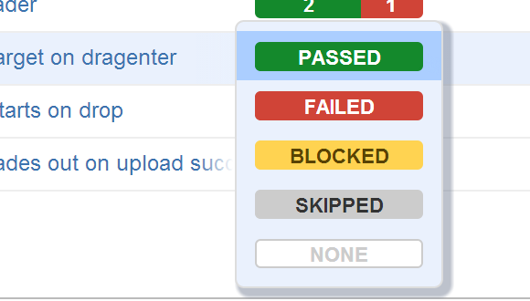
TEST EXECUTION
Automation scripts are executed during this phase
The scripts need input test data before there are set to run
Once executed they provide detailed test reports ensuring that test results are easily interpretable
Execution can be performed using the automation tool directly or through
the Test Management/CI tool which will invoke the automation tool

Slide 15
TEST EXECUTION
Smoke Suite
Is a sanity check that the application can be loaded and accessed
Just a few key scenarios should also be run to make sure application is still functional
The aim of the smoke test pack is to catch the most obvious issues, such as application not loading,
or a common user flow cannot be executed
The smoke tests should last no longer than 5 minutes to give quick feedback in case something major is not working
Functional Regression Suite
Which is meant to check the functionality of the application in more detail than the smoke test
Multiple regression packs shall exist for different purposes.
If there are multiple teams working on different sections of the application, then ideally there should be different regression
packs that can be focused on the area the team is working on
Executed multiple times a day and should last no longer than 15 to 30 minutes

Slide 16
TEST EXECUTION
Smoke Suite
Is a sanity check that the application can be loaded and accessed
Just a few key scenarios should also be run to make sure application is still functional
The aim of the smoke test pack is to catch the most obvious issues, such as application not loading,
or a common user flow cannot be executed
The smoke tests should last no longer than 5 minutes to give quick feedback in case something major is not working
Functional Regression Suite
Which is meant to check the functionality of the application in more detail than the smoke test
Multiple regression packs shall exist for different purposes.
If there are multiple teams working on different sections of the application, then ideally there should be different regression
packs that can be focused on the area the team is working on
Executed multiple times a day and should last no longer than 15 to 30 minutes

Slide 17
MAINTAINANCE
As new functionalities are added to the System Under Test with successive cycles, automation Scripts need to be added,
reviewed and maintained for each release cycle
Maintenance becomes necessary to improve the effectiveness of automation scripts
Framework Approach

Slide 18
FARMEWORK FOR AUTOMATION
A framework is set of automation guidelines which help in
Maintaining consistency of Testing
Improves test structuring
Minimum usage of code
Less Maintenance of code
Improve re-usability
Non Technical testers can be involved in code
The training period of using the tool can be reduced
Involves Data wherever appropriate
There are four types of frameworks used in automation software testing
Data Driven Automation Framework
Keyword Driven Automation Framework
Modular Automation Framework
Hybrid Automation Framework

Slide 19
BEST PRACTICES
To get maximum ROI of automation, observe the following:
I. Scripting Standards
Standards have to be followed while writing the scripts for Automation
Create uniform scripts, comments, and indentation of the code
Adequate Exception handling - How error is handled on system failure or unexpected behavior of the application
User-defined messages should be coded or standardized for Error Logging for testers to understand
II. Measure metrics
Success of automation cannot be determined by comparing the manual effort with the automation effort
but by also capturing the following metrics
Percent of defects found
The time required for automation testing for each and every release cycle
Customer Satisfaction Index
Productivity improvement

Slide 20
BENEFITS OF TA
70% faster than the manual testing
Wider test coverage of application features
Reliable in results
Ensure Consistency
Saves Time and Cost
Improves accuracy
Human Intervention is not required while execution
Increases Efficiency
Better speed in executing tests
Re-usable test scripts
Test Frequently and thoroughly
More cycle of execution can be achieved through automation
Early time to market

Slide 21


CLOUD PROVIDERS
SauceLabs
BrowserStack

